Slide 1

PAKISTAN’S ECONOMY
Comparision and Analysis of growth over years and its related sectors
Course Instructor: Sir Osama Ejaz

Slide 2
TEAM MEMBERS
Muhammad Zunique (20K-0145)
Ammar Siddiqui (20K-0177)
Ali Abdullah (20K-0248)
Muhammad Muaz Zafar (20K-0363)

Slide 3

Abstract Summary
We have selected this topic in order to analyze the current situation of Pakistan’s economy over different sectors over the past many years and compare it with the current situation of Pakistan’s economy, So that we can predict where we can have this in the coming years and what major steps do we need to take to make it more stable
The major sectors we will be focusing on are:
Import & export %
Population Growth and Death rates
Population Ratios
Military Expenditures & Arms Resources
GDP
Agriculture v/s Industrial
Inflation Rate

Slide 4
OBJECTIVE
This report made us to comprehend that how Pakistan’s economy have been through in different sectors over the year soon after its creation uptill yet.

Slide 5
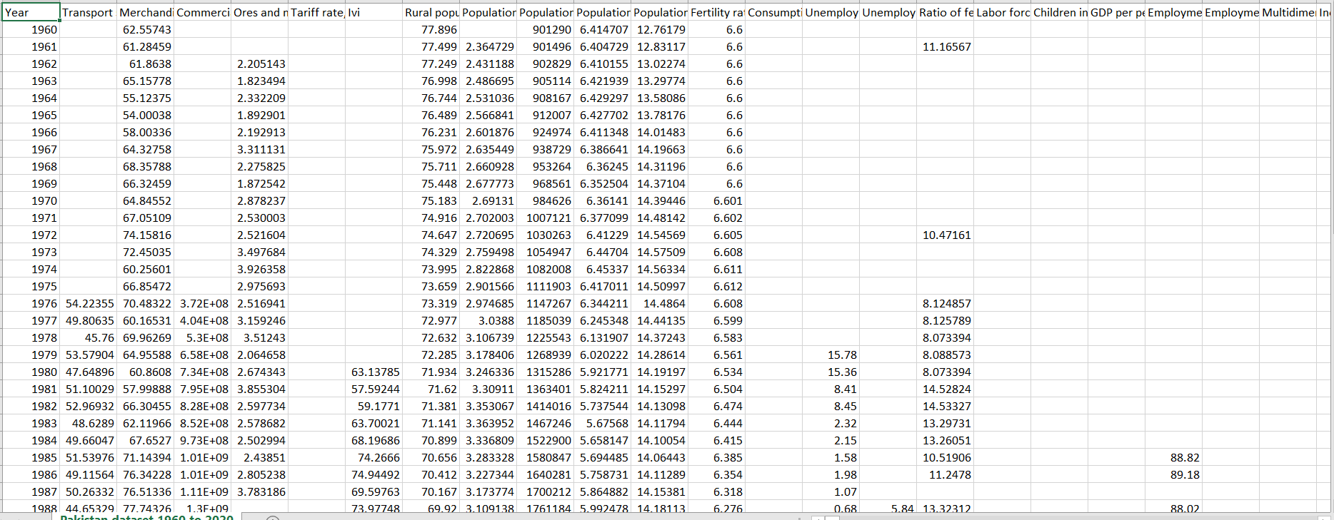
DATA COLLECTION AND METHODOLOGY:
Data has been collected from online website KAGGLE.

Slide 6
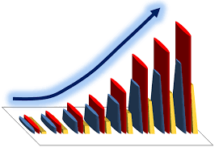
STATISTICAL EXPLANATION

Slide 7
Import Volume Index:
World export (import) volumes are constructed by aggregating measures of the volume of exports (imports) of individual countries on a constant price basis.

Slide 8
Import Volume Index:
QUANTITY | VALUE
Mean | 113.5091
Median | 102.5604
Minimum | 57.59244
Maximum | 226.2163
St Deviation | 43.1445
Since here mean > median, so Import Volume is positively skewed.
IQR = 62.30552 , we calculated that there are no outliers.
43% SD tells that data is almost evenly spread out from the mean.

Slide 9
Export Volume Index:
World export (import) volumes are constructed by aggregating measures of the volume of exports (imports) of individual countries on a constant price basis.

Slide 10
Export Volume Index:
QUANTITY | VALUE
Mean | 133.9299
Median | 101.1629
Minimum | 26.54699
Maximum | 281.1533
St Deviation | 87.67622
Since here mean > median, so Export Volume is positively skewed.
IQR = 165.78 , we calculated that there are no outliers
87% SD tells that data is more spread out from the mean.

Slide 11
GDP Growth and Trade(as per GDP):
This analysis shows that our inflation rate is increasing more frequently than our GDP on average.
We can see there is a big prominent outlier in Inflation rate during the year b/w 2006 – 2010.
% Average | Change
GDP Growth | 5.120954
Inflation Rate | 8.604486

Slide 12
Linear Regression to Predict GDP on Basis of Inflation:
Slope : - 0.77939 , showing GDP will decrease if inflation increase.
Correlation : -0.28011, also determines that there is reciprocal relation between these two variables.
Intercept : 12.53209 shows GDP will remain on this, if inflation becomes constant/zero.

Slide 13
Military Expenditure v/s GDP Growth:
Military Expenditure:
 | Measure
Mean | 5.138579
Max | 6.35346
Min | 3.265224
GDP Growth:
 | Measure
Mean | 5.120954
Max | 11.35346
Min | 0.468373

Slide 14
URBAN v/s RURAL:
The graph clearly represent that urban population is growing at a faster rate than rural population yearly.
Average Rural Growth Rate : 2.31
Average Urban Growth Rate : 3.54

Slide 15
Regression Model to predict Growth Rates:
Analysis shows that Urban population growth rate is decreasing for past few years and for same rural is going on a constant rate.
So, by this multiple regression model of growth rates we can predict that in near future both will go on an average of same rate.
Correlation is 0.9 , showing that both will move on in same direction overall.

Slide 16
Since after discussing the growth rate we have to take a look at death rate percentage collected over from different areas of country and it shows that the death rate is exponentially decreasing as it was in the beginning(collected over 1000 persons per area).
On average uptil yet 11.37% is death rate with SD of 3.6.
We can see for the past 20 years as well rate is decreasing but not at the greater rate as it was before with an average of 7.54% and SD of 0.5.

Slide 17
Population Ratios
This shows that early female population was greater than that of male ratio during first half.
But now going at a constant rate separately for a decent amount of time.
Further on next slide….

Slide 18
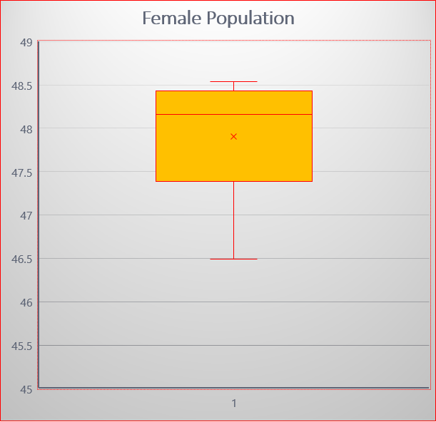
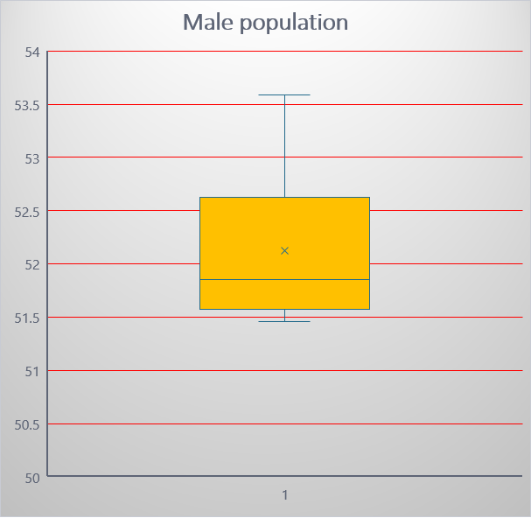

Slide 19
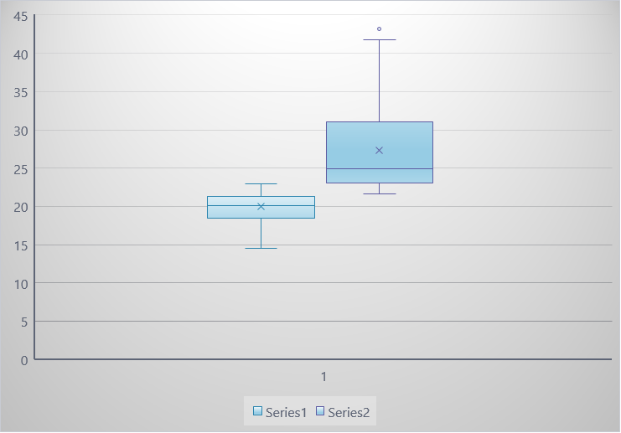
Agriculture v/s Industry
It is clearly observed from the history of Pakistan that Pakistan always be dependent on both of its sectors from the very beginning.
Here is value added sum up story from 1960’s uptil yet.

Slide 20
Industry v/s Agriculture (% of GDP)
From the Graph it is clearly seen that Pakistan was pretty dominant in the field of agriculture as compare to the industrial value added rate.
Graph of Agriculture is decreasing with time but industry almost going on the same rate as was before.
Due to that as we saw in the previous slide how much mean in deviated from the median for agriculture sector and for industry it just around median.

Slide 21
PIE CHART DISTRIBUTION
1 – Gross Domestic saving
2 – Trade %
3 – Export of Goods
4 – Industrial sector
5 – Agricultural sector
6 – Imports
7 – Military Expenditures

Slide 22
HYPOTHESIS TESTING
HYPOTHESIS TESTING

Slide 23
Definition
Hypothesis testing is a statistical method that is used in making statistical decisions using experimental data.
Hypothesis Testing is basically an assumption that we make about the population parameter.

Slide 24
One sample T-test on GDP % :
t-Test: One-Sample
 | Values
Mean | 5.034455
Variance | 6.106022
Observations | 60
Hypothesized Mean | 5
df | 59
t Stat | 0.108006
P(T<=t) one-tail | 0.457179
t Critical one-tail | 1.671093
Null Hypothesis: The underlying
% of GDP is Ho = 5
Alternative Hypothesis: H1 ≠ 5.
First on Confidence Interval of 95%.

Slide 25
One sample T-test on GDP % :
Rejection Region:
Reject Ho if t > 1.67
Test Statistics : t-value = 0.108
P-value = 0.458
Conclusion:
Because t = 0.108 < 1.67,
So our NULL HYPOTHESIS can be accepted.

Slide 26
One sample T-test on GDP % :
t-Test: One-Sample
 | Values
Mean | 5.034455
Variance | 6.106022
Observations | 60
Hypothesized Mean | 5
df | 59
t Stat | 0.108006
P(T<=t) one-tail | 0.457179
t Critical one-tail | 1.296066
Now on Confidence Interval of 90%.

Slide 27
CONCLUSIONS:
Since the p-value is greater than 0.05 , therefore it can be concluded that our population is not significantly different.
Since as per rule t-value is not greater than critical test value.
So, we can accept our NULL hypothesis.

Slide 28
Independent Two Sample T-test:
We are comparing two sectors Industry and Agriculture.
That whether the industrial sector is adding to more to our GDP than agricultural sector for unknown variances?
µa = population mean for agriculture
µi = population mean for industry
First we perform a F-test to check whether we go for equal variance or unequal variance T-test , results are attached,
F-Test Two-Sample for Variances
 | Agriculture | Industry
Mean | 27.314955 | 19.94321
Variance | 32.18300715 | 3.224201
Observations | 61 | 61
df | 60 | 60
F | 9.981699426
P(F<=f) one-tail | 2.46431E-16
F Critical one-tail | 1.53431418
Therefore by this test we conclude that we are performing Unequal Unknown variance Independent Two sample T-test

Slide 29
Independent Two Sample T-test:
Null Hypothesis:
µi ≤ µa or µi - µa ≤ 0
(Industrial sector is adding less than equal to GDP as compare to Agricultural)
Alternative Hypothesis :
µi > µa or µi - µa > 0
(Industrial sector is adding more to GDP as compare to Agricultural)
CONFIDENCE INTERVAL = 95%

Slide 30
Independent Two Sample T-test:
t-Test: Two-Sample Assuming Unequal Variances
 | Agriculture | Industry
Mean | 27.314955 | 19.94321
Variance | 32.18300715 | 3.224201
Observations | 61 | 61
Hypothesized Mean Difference | 0
df | 72
t Stat | 9.675856924
P(T<=t) one-tail | 5.83314E-15
t Critical one-tail | 1.293420507
P(T<=t) two-tail | 1.16663E-14
t Critical two-tail | 1.666293696

Slide 31
Independent Two Sample T-test:
Rejection Region:
Reject Ho if t > 1.29
Test Statistics : t-value = 9.68
P-value = 5.83 E-15
Since,
Because t = 9.68 > 1.29,

Slide 32
CONCLUSIONS:
Since the p-value is lesser than 0.05 , therefore it can be concluded that our population is significantly different.
Since as per rule t-value is greater than critical test value.
So, we can reject our NULL hypothesis, stating that there is not enough evidence to reject our hypothesis.

Slide 33


